Slide 1
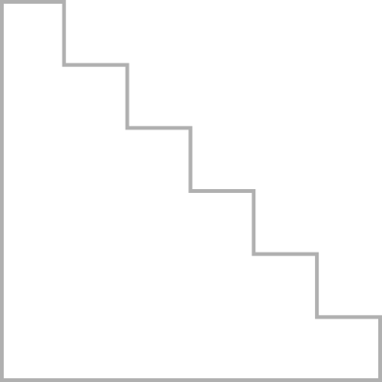





MACHINE LEARNING REINFORCEMENT
BANK CUSTOMER CHURN PREDICTION
By
KAVIYA C
DADS[JULY]

Slide 2
PROBLEM OVERVIEW & OBJECTIVE
Customer churn is a major challenge for banking institutions, as losing existing customers directly affects revenue, growth, and long-term sustainability. Understanding the factors that influence whether a customer will leave the bank is essential for designing effective retention strategies. The given dataset contains detailed customer information, including demographics, account behavior, credit score, product usage, and past activity. However, identifying which customers are at risk of churning from this complex data is not straightforward. The deployment ensures that insights from the model are accessible to business teams for informed decision-making.

Slide 3
DATA UNDERSTANDING
DATASET DESCRIPTION
The Bank Customer Churn dataset contains detailed information about customers, including personal demographics, credit scores, account balances, tenure with the bank, number of products used, and transaction-related behavior. It also includes an important feature indicating whether a customer has exited (churned) or remained with the bank. The dataset provides a mix of numerical and categorical variables that help understand customer behaviour and the factors influencing churn. This data forms the foundation for building predictive models and extracting useful insights related to customer retention.

Slide 4
COLUMN DESCRIPTION
  Customer Id: Unique identifier for each customer.
  Surname: Customer’s last name.
  Credit Score: Numerical value indicating the customer’s creditworthiness.
  Geography: Country or region where the customer lives.
  Gender: Male or Female.
  Age: Customer’s age, which influences financial decisions.
  Tenure: Number of years the customer has been with the bank.
  Balance: Account balance maintained by the customer.
  Num Of Products: Number of banking products the customer uses.
  Has Cr Card: Indicates if the customer owns a credit card (1 = Yes, 0 = No).
  Is Active Member: Shows whether the customer is actively using bank services.
  Estimated Salary: Approximate yearly income of the customer.
  Exited: Target column showing whether the customer churned (1 = Yes, 0 = No).

Slide 5
DATA CLEANING
The data cleaning process ensures the dataset is accurate, consistent, and ready for model building. First, the Customer ID column was dropped because it is only an identifier and does not contribute to predicting churn. The dataset was checked thoroughly for missing values and duplicates, and none were found, confirming the data was already complete and unique. This reduced the need for additional imputation or duplicate removal steps.
The dataset contained no missing values or duplicates, so no imputation was required. Categorical features were encoded for model compatibility: the Gender column was converted into numeric values (Male = 1, Female = 0), and the Geography column was mapped to numerical codes for each country. These encoding steps ensured all categorical variables were transformed into machine-readable formats, enabling the Random Forest model to process the data efficiently.

Slide 6
EXPLORATRY DATA ANALYSIS
Key Visualizations
Bar charts, histograms, boxplots, and a correlation heatmap were used to explore customer behaviour. These visualizations highlighted how features like age, balance, geography, and activity levels differ between churned and non-churned customers.
Key Insights
EDA showed that churn was higher among older customers, inactive members, and those with lower credit scores or fewer products. Certain countries had higher churn rates, while customers with higher balances were more likely to stay. These insights helped identify the most important predictors for the churn model.

Slide 7
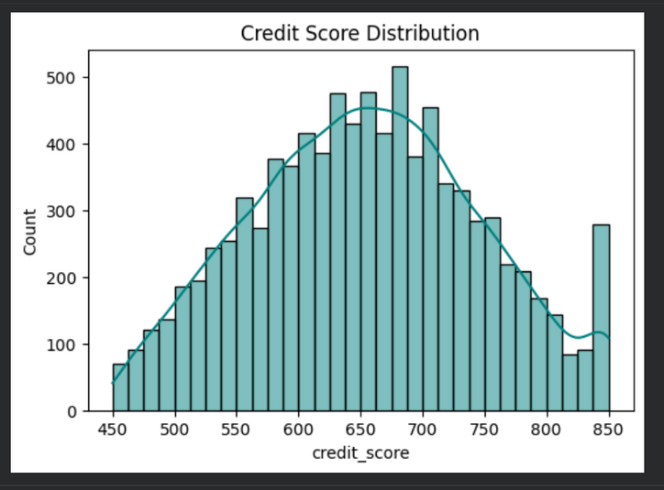
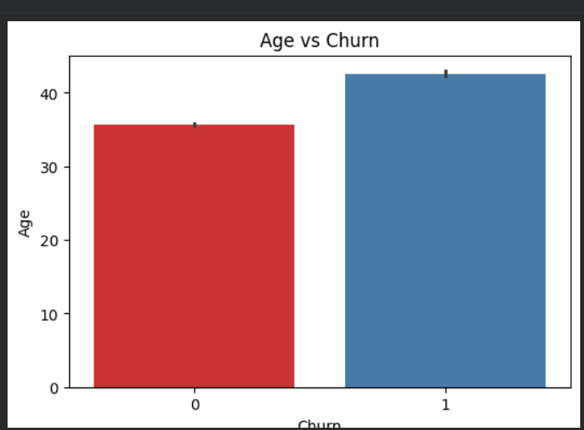
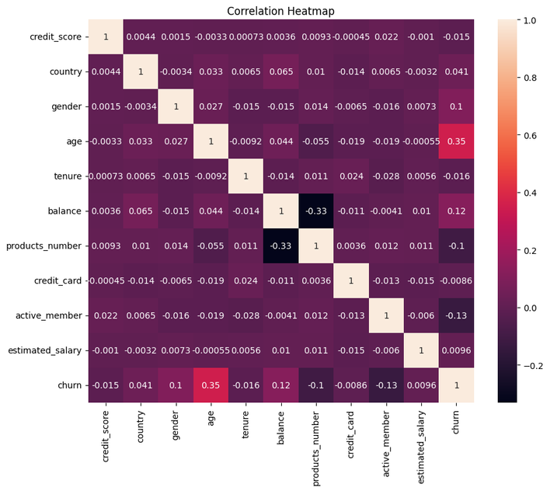

Slide 8
MODELING PROCESS
Models Used
Several machine learning models were tested, including Logistic Regression, SVM, KNN, Decision Tree, Random Forest, and XGBoost. These models were compared to identify the accurate and reliable option for predicting customer churn.
Hyperparameter Tuning
Hyperparameter tuning was performed using Random Search, which efficiently explored a wide range of parameter combinations to find the best settings, especially for models like Random Forest and SVM.
Evaluation Metrics
The models were evaluated using accuracy, precision, recall, F1-score, and the confusion matrix to measure classification performance and understand how well the models identified churned and non-churned customers.

Slide 9
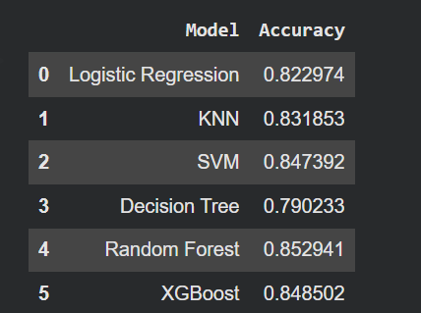
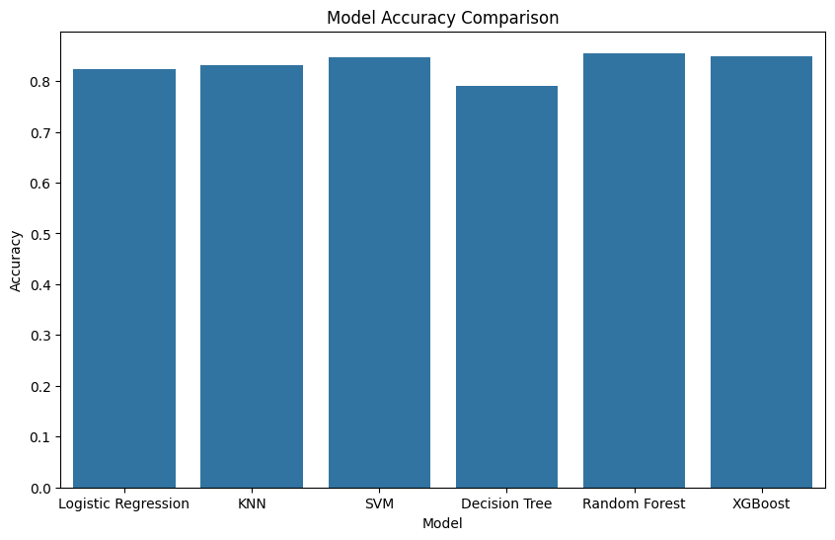
MODEL COMPARISON
The performance of all trained models including Logistic Regression, SVM, KNN, Decision Tree, Random Forest, and XGBoost was compared using accuracy the Random Forest model emerged as the best performer, showing the highest accuracy .

Slide 10
CONCLUSION
The model can be improved by further tuning hyperparameters, adding more relevant features, and exploring advanced algorithms for better accuracy. Future steps include expanding the dataset, integrating real-time data for live predictions, deploying the model on scalable platforms, and using explainability tools to help the bank understand churn drivers and take targeted retention actions.

Slide 11
THANK
YOU

